Slide 1

Optimal Allocation of Limited Vaccines
From Initial Doses to Boosters
Isabelle Rao, University of Toronto
Margaret Brandeau, Stanford University
IMSI: Advances in Quantitative Medical Care
February 2, 2026

Slide 2
Twin epidemics of COVID-19 and opioid use disorder
78.8 years
77 years
76.1 years
Operations research
Epidemiology
Health policy
Source: CDC
  COVID-19 deaths: 66% of the decline
  Drug overdose deaths: 5% of the decline
Notes:
I want to start by providing some motivation for my research. Over the past few years, through public health crisis such as COVID-19 and opioid use disorder, it has become clear that we are unprepared for epidemics. Part of the trouble is that we don’t know how to respond to epidemics. And that has led to substantial losses in health and life. During the COVID-19 pandemic, the life expectancy at birth in the US declined by nearly three years from 2019 to 2021, reaching 76.1 years, its lowest level since 1996. That decline was largely driven by the pandemic. COVID-19 deaths contributed to 66% of the decline. And drug overdose deaths was the second cause, contributing to another 5% of the decline.
Through my research, I integrate tools from operations research, epidemiology, and health policy to design more effective responses for epidemic control.
Heart and chronic liver disease.

Slide 3
Today’s talk
  Interpretable approach to allocate limited vaccines
Optimal allocation of limited vaccine to control an infectious disease. Mathematical Biosciences, 2021
Vaccination for communicable endemic diseases: optimal allocation of initial and booster vaccine doses, Journal of Mathematical Biology, 2024
Notes:
Today, I will present how we developed an interpretable approach to allocate limited supplies of vaccines to control the spread of an infectious disease. This work is based on these two following papers.

Slide 4
Allocating COVID-19 vaccines
The goal of the committee’s framework for equitable allocation of COVID-19 vaccine is to reduce severe morbidity and mortality and negative societal impact due to the transmission of SARS-CoV-2.
-- National Academies of Sciences, Engineering and Medicine. Framework for Equitable Allocation of COVID-19 Vaccine. Washington, DC, 2020
  Goals are not necessarily compatible
    COVID-19: vaccinate older people to reduce deaths, younger people to reduce transmission
Notes:
For many epidemic diseases such as COVID-19, vaccination is an essential part of control. However, vaccine supplies are often constrained. So when allocating these limited vaccines, policy makers frequently have goals relating to individual as well as population-level health benefits. For example, a report from the National Academy of Sciences, Engineering and Medicine on equitable allocation of COVID-19 vaccine states that ‘‘The goal of the committee’s framework is to reduce morbidity, mortality, and negative societal impact due to the transmission of the virus’’.
However, such goals are not necessarily compatible.
If we think about the case of COVID-19, if the goal is to reduce deaths in the short term, then vaccines should be allocated to older people because they have a higher mortality rate. But if the goal is to reduce transmission, then vaccines should be allocated to younger people, because they are more likely to acquire and then spread the infection.

Slide 5

Research goals
  Determine optimal allocation of a limited supply of a vaccine to control an infectious disease
  Explore the impact of four different objectives
    Minimize new infections
    Minimize deaths
    Minimize life years lost
    Minimize quality-adjusted life years (QALYs) lost
# QALYs = Years of life * Utility value Utility $∈[0,1]$
Notes:
In this paper, I aim to address two key research questions: which are how should vaccines be allocated? And how does the optimal allocation depend on the objective considered? Specifically, I consider four objective functions, which are minimizing new infections, deaths, life years lost, or quality-adjusted life years lost (or QALYs lost for short)
For those who are not familiar with QALYs, they are commonly used in health economics to measure health outcomes. They are calculated as the years of life multiplied by the utility value. This utility measures the quality of life for one year and is between 0 and 1, where 0 represents death and 1 represents perfect health. Utilities can be estimated from health surveys.

Slide 6
Literature on vaccine allocation
  Mixed-integer or linear programming problem
    [Becker, 1997; Tanner, 2008; Enayati, 2019]
  Optimal control
    [Rodrigues, 2014; Yuzo, 2019]
  Age-structured compartmental models with numerical simulations
    Seasonal influenza: [Mylius, 2008; Tuite, 2010; Matrajt, 2010; Medlock, 2009]
    COVID-19: [Babus, 2020; Chen, 2020; Bertsimas, 2020, 2021; Matrajt, 2021]
Black box or simulation models that solve a specific instance and lack transparency
Notes:
There are a number of papers that have focused on this problem. Some studies dating all the way back from 1997 formulate the problem as a mixed-integer or linear programming problem with the goal of minimizing the number or the cost of vaccines such that infections do not spread.
Other studies use an optimal control formulation to determine the continuous allocation of vaccine with the goal of minimizing vaccination cost added to the cost of infection.
Some researchers use age-structured compartmental models and they then use numerical simulations to evaluate the impact of different vaccination strategies. They apply these models to seasonal influenza or COVID-19 more recently.
Because of the complex epidemic dynamics, most of the optimization models that I just discussed do not have an analytical solution. Therefore black box models or simulations are prevalent in the literature on vaccine allocation. And this can lead to a few limitations in my opinion. First of all, these studies only solve a specific instance of the problem, and they require careful calibration of the epidemic parameters. These parameters can in turn have a major influence on the model predictions and results. Secondly, they lack transparency and do not provide insight into the reasons behind the optimal allocation.
Update literature review

Slide 7
Research goals
  Determine optimal allocation of a limited supply of a vaccine to control an infectious disease
  Explore the impact of four different objectives
    Minimize new infections
    Minimize deaths
    Minimize life years (LYs) lost
    Minimize quality-adjusted life years (QALYs) lost
  Contributions
    General theoretical framework with interpretable analytical solution
    Near optimal solution
    Provide intuition for decision makers
Notes:
In this paper, I want to /add to this body of work/address this gap in the literature/ by developing a model that is very simple to interpret and to implement. So if we go back to the research goals, more than determining the optimal vaccine allocation, and how it depends on the objective, I want to give policy makers intuition behind the tradeoffs of these objectives. I propose a general theoretical framework to inform vaccine allocation. By approximating epidemic dynamics, I derive a novel analytical solution. I will later show you that this analytical solution is a greedy allocation that is very simple to communicate to policy makers, and is also easy to implement. I then show with numerical simulations calibrated to COVID-19 epidemic data that the approximated solution is near optimal. This ultimately allows me to provide intuition to decision makers as they allocate vaccines over time. What I do here is that I break down the problem to its simplest parts to gain intuition on the solution.

Slide 8







Susceptible-Infected-Removed (SIR) model
Susceptible
$$β$$
Infected
  Differential equations
$$R$$
Recovered
$$γ$$
$$S$$
$$I$$
Force of
infection
$$μ$$
$$D$$
Dead
Notes:
To answer these questions, I use an SIR model which stands for Susceptible-Infected-Removed model. It’s a classical model of disease transmission within a population. Here I present the most basic model as a building block for the model that I developed.
Let’s start with susceptible individuals. These are individuals who might become infected through contact with another infected individual.
Susceptible individuals become infected at a rate which /depends on/is a product of/ the size of the susceptible and infected compartments, and the amount of transmission that is happening. I denote by beta the transmission rate.
Infected individuals can then either recover at rate gamma, which is the recovery rate, or die at rate mu which is the mortality rate. Once recovered, an individual can no longer become infected.
The SIR model is governed by this system of differential equations.
For each compartment, the rate of change is calculated by adding the flow coming into the compartment and subtracting the flow out of the compartment. Since susceptible individuals can only become infected at a rate beta*I, the rate of change is simply minus S*beta*I. The other equations follow the same pattern. The key point here is that this system is nonlinear because of the disease transmission dynamics. Point to nonlinear term.
I want to define one term here, which will be important later in the results. The yellow term is called the force of infection, which is the per capita rate at which susceptible individuals become infected and is the transmission rate multiplied by the infected compartment size.

Slide 9


























SIR model – $n$ groups
Susceptible
$$β_{11}$$
Infected
  Differential equations
  Nonlinear system
$$R_{1}$$
Recovered
$$γ_{1}$$
$$S_{1}$$
$$I_{1}$$
Force of
infection
$$β_{21}$$
$$μ_{1}$$
$$D_{1}$$
Dead
$$β_{12}$$
$$R_{2}$$
$$γ_{2}$$
$$S_{2}$$
$$I_{2}$$
$n$ groups
$$β_{22}$$
$$μ_{2}$$
$$D_{2}$$
. . . . . . .
$$β_{n1}$$
$$β_{n2}$$
$$R_{n}$$
$$γ_{n}$$
$$S_{n}$$
$$I_{n}$$
$$D_{n}$$
$$μ_{n}$$
$$β_{nn}$$
Notes:
In the problem I consider, I divide the population into different groups to determine which one should be vaccinated first. That can be based on any characteristic such as age, location, race, or occupation. I consider an arbitrary number of population groups, which I denote by n. I start with the same building block that I just presented, and repeat it n times, one time for each group. The population groups are interacting, which means that susceptible individuals can acquire infection from contact with infected individuals in any group. 𝛽_𝑖𝑗 denotes the transmission rate from group j to group i.
The model evolves over time according to this system of differential equations.
The main difference here is that the rate of change of the susceptible compartment depends on the infected compartment size of all groups.
The force of infection is the sum across all groups of the transmission rate multiplied by the infected compartment size.
One of the challenges of this problem is that there exists no general method to solve nonlinear systems of ODEs analytically. Such systems usually rely on numerical solutions using finite difference methods.

Slide 10
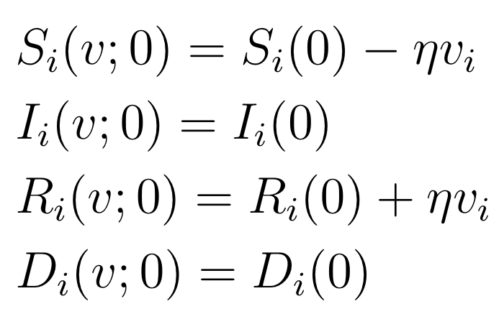

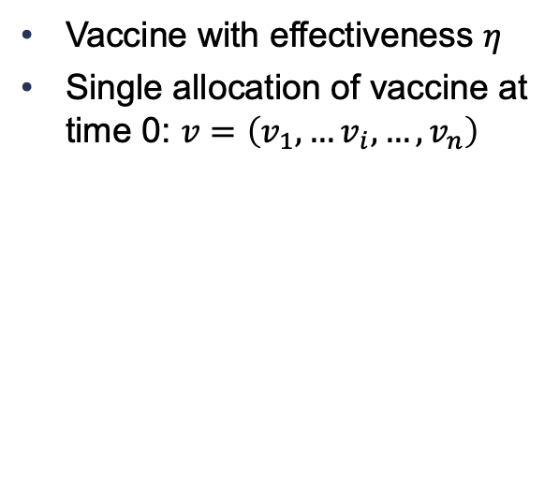


Effect of vaccination
$$ηv_{1}$$
$$β_{11}$$
$$R_{1}$$
  Vaccine with effectiveness $η$
  Single allocation of vaccine at time 0: $v=\left(v_{1},…v_{i}, …,v_{n}\right)$
$$γ_{1}$$
$$S_{1}$$
$$I_{1}$$
$$β_{21}$$
$$μ_{1}$$
$$D_{1}$$
$$ηv_{2}$$
$$β_{12}$$
$$R_{2}$$
Susceptible
$$γ_{2}$$
$$S_{2}$$
$$I_{2}$$
Infected
$$β_{22}$$
$$μ_{2}$$
$$D_{2}$$
Recovered
. . . . . . .
Dead
$$ηv_{n}$$
$$β_{n1}$$
$$β_{n2}$$
$$R_{n}$$
$$γ_{n}$$
$$S_{n}$$
$$I_{n}$$
$$D_{n}$$
$$μ_{n}$$
$$β_{nn}$$
Notes:
I then introduce a preventive vaccine to the model. I denote by $η$ its effectiveness. And I assume that a limited number of vaccines are available to be allocated at time 0.
I denote by v, which is an n dimensional vector, the vaccine allocation to each group. Specifically, v_i is the proportion of individuals vaccinated in group i.
Since the vaccine is not perfect, I assume that a proportion $η$ of susceptible vaccinated individuals become fully immune to the disease. They can no longer infect other susceptible individuals. Therefore, a proportion $η$ * v_i of individuals in group i move from the susceptible to the recovered group due to vaccination.

Slide 11
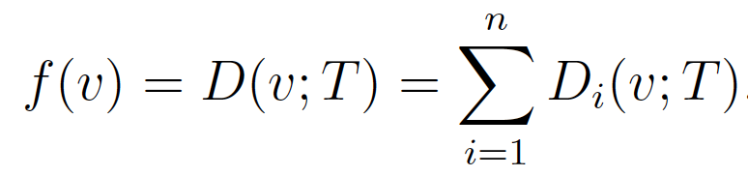
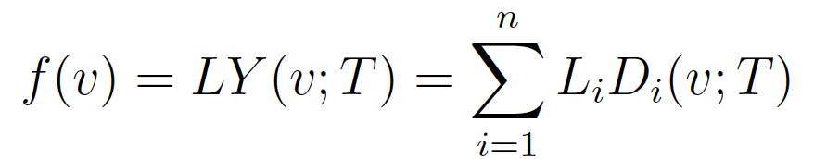
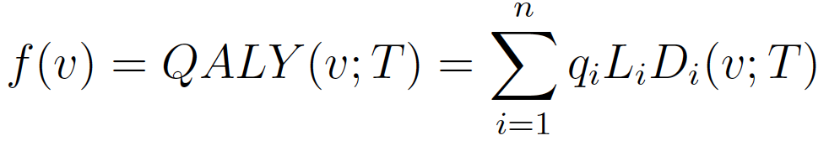


Objective functions
    Infections:
    Deaths:
    Life years lost:
    QALYs lost:
$L_{i}$: expected LYs lost
$q_{i}$: utility
Notes:
As I mentioned earlier, I consider four different objective functions for the vaccine allocation problem. They are functions of v, the vaccine allocation, and also of T, which is the time horizon I consider.
For infections, I sum the proportion of people who have been infected. They are either still infectious, have recovered, or have died.
For deaths, I simply sum the proportion of people who have died.
To get life years lost, I multiply the proportion of people who have died by the expected life years lost Li in each group, and sum across all groups.
To get QALYs lost, I further multiply the expected life years lost by the utility q_i, which measures the quality of life for one year and is between 0 and 1.
I only consider QALYs that are lost due to deaths, I do not take into account QALY losses that occur when an individual is infected.
We have this minus eta*v_i because we have artificially moved some people to the recovered group due to vaccination.

Slide 12
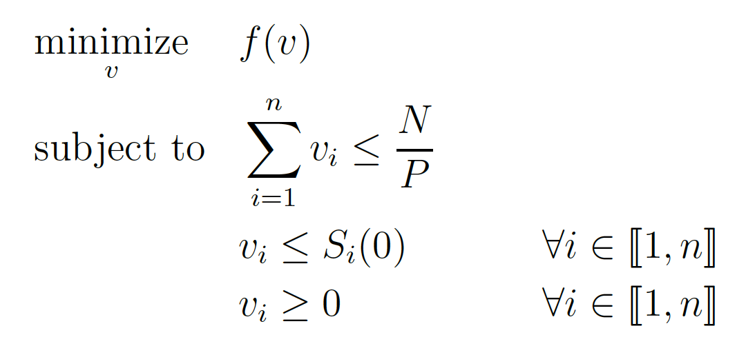
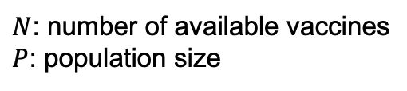
Optimization problem
4 objectives: new infections, deaths, LYs lost, QALYs lost
vaccine supply
susceptibles
nonnegativity
$N$: number of available vaccines
$P$: population size
No analytical solution
Notes:
Now let’s formalize the optimal vaccine allocation problem.
I want to minimize this function f over the vaccine allocation v. f is one of the 4 objective functions I just described.
I have constraints on the vaccine allocation. The vaccine supply is limited to N/P, where N is the number of available vaccines and P the population size.
Allocation to each group is limited by the starting susceptible population size, and must be nonnegative.
Because the objective function depends on the nonlinear system of differential equations of the SIR model, the problem formulated here does not have an analytical solution.

Slide 13

Solution approach
Approximate disease dynamics using first and second order Taylor expansion
With sufficient levels of vaccines $v,$ the approximation of $I_{i}$ can be negative, and $D_{i}$ can be decreasing
Force of
infection
a
Time
Notes:
In order to solve this, I simplify the problem by approximating the disease dynamics over the considered time horizon. I use first- and second-order Taylor expansions to linearize the nonlinear system of ODEs that governs the SIR model.
Before I go into the results, I want to give you some intuition as to why these approximations can yield good insight. This plot here shows the evolution of the infected compartment sizes over time for an SIR model with two interacting groups. We have this S shape curve here because of the bilinear term in the rate of change dI/dt. For the objective of minimizing infections, I use first order Taylor approximations. As a refresher, first order Taylor expansions approximate the function locally by linearizing it. Here I just show this at an arbitrary time a. One other interesting thing to note here which might give some intuition later on, is that when infections are spreading, the force of infection is the leading term in dI/dt and it’s a good measure of the spread of the infections in each group: the larger the force of infection, the faster infections are spreading (in that group).
One other thing that I want to point out is that we need to be careful when handling these approximations. If vaccine levels are too high, then the approximation of infections can be negative, and the approximation of deaths can be decreasing, which would be nonsensical. Let me provide some more details as to why this happens.

Slide 14







Taylor expansions
$$β$$
$$R$$
$$γ$$
$$S$$
$$I$$
$$D$$
  Infections
    SIR:
    Approximation:
    Additional constraint:
$$μ$$
Incoming flow
Outgoing flow
Notes:
Let’s look at the case of minimizing infections first. Here is the exact equation from the SIR model. We saw earlier that the rate of change of the infected compartment is simply the incoming flow minus the outgoing flow. When the infected compartment size is equal to 0 then so is this term, so the infected compartment size is always positive.
Let’s look at what happens when I use the approximation. Specifically, I use Taylor expansions at time 0, since I assume that vaccines are allocated at time 0. I denote by I\tilde the approximation of infections. With the approximation, the rate of change of infections at any time t, dI tilde / dt, is constant and equal to the rate of change at time 0. If I \tilde = 0, the rate of change won’t adjust as it does with the SIR model, I tilde could keep decreasing and become negative.
Let’s make that even more precise. We can write the approximation of the infected compartment size (I tilde), with vaccination level v, measured over the time horizon T. It is simply the size at time 0, plus the incoming flow * the time horizon T minus the outgoing flow times T. If vaccination level is too high, fewer people are susceptible and the outgoing flow becomes greater than the incoming flow, resulting in a negative size for the infected compartment.
I need to add this constraint: v_i has to be smaller than this quantity I calculated, that I denote by alpha_i which depends on the epidemic parameters and the starting population sizes. (You can think of this as a flow constraint.)
This constraint also makes sense in the real-world, as vaccine supply is limited anyways.
Not going to do this here but can show that with this same constraint, deaths remain increasing.

Slide 15
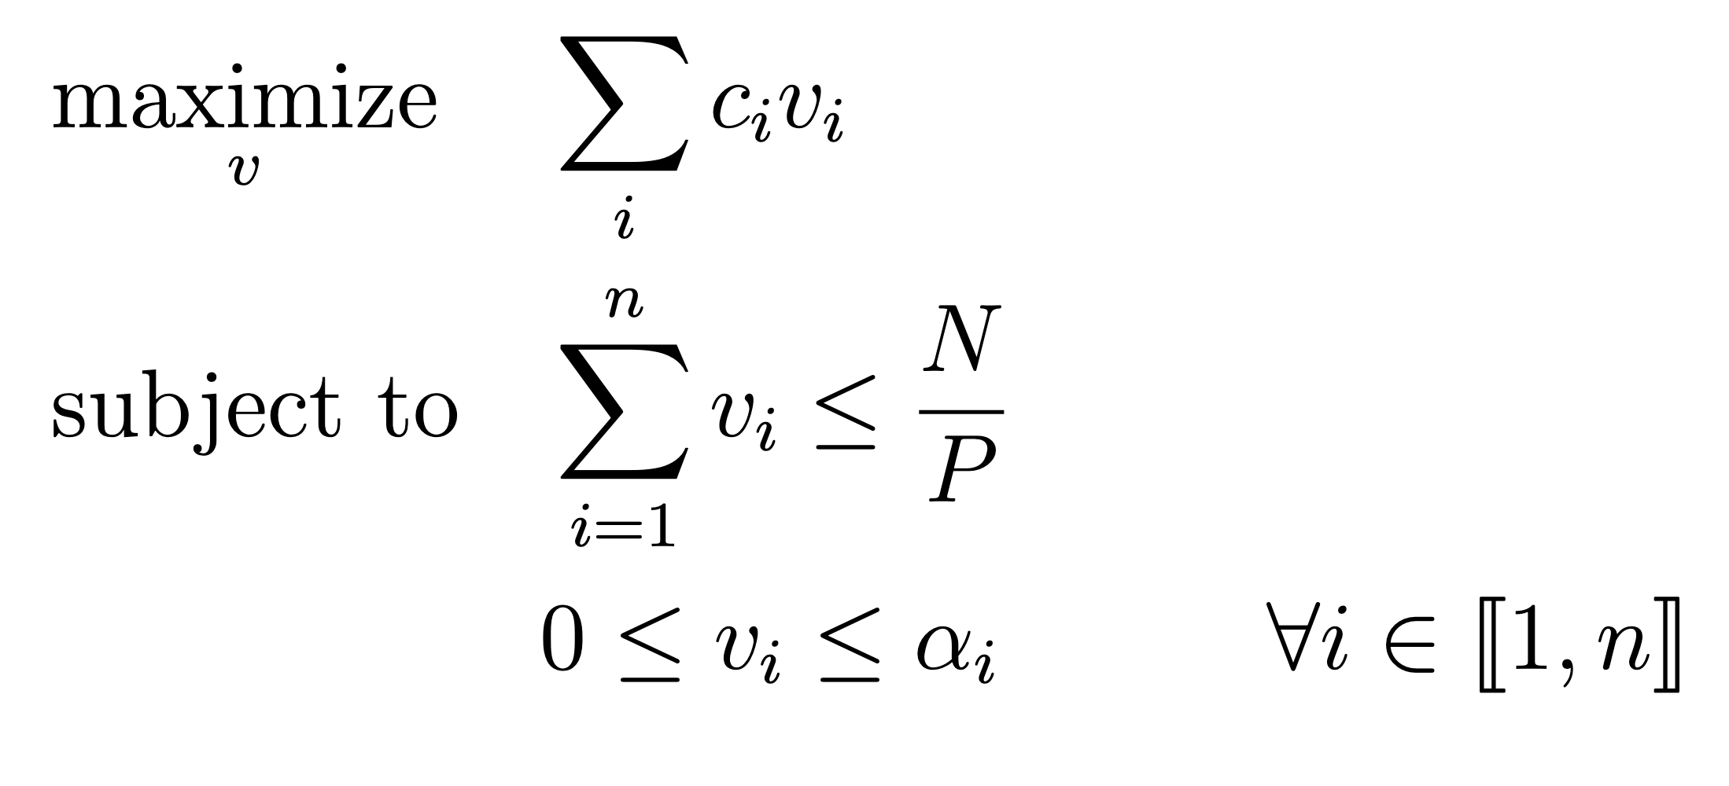


Linear programming problem
  Additional constraint:
  Assume:
  Problem reduces to a linear programming (LP) problem
Greedy solution
Group 1
Group 2
Group 3
Notes:
Now that we know the limitations of the approximation, let's go back to the optimal vaccine allocation problem. I need to add this constraint v_i < alpha_i to ensure that the approximations are realistic.
In order to simplify the problem and to ensure that this constraint is satisfied, I further assume that the number of available vaccine is limited to the minimum across all groups of alpha_i. With this assumption, I prove that the optimal vaccine allocation problem reduces to a linear programming problem for all four objective. I am maximizing this objective function, which is a linear function of the vaccine allocation, where the coefficients c_i are positive and depend on the objective. And the constraints are linear in v as well. I show that the optimal solution to this linear programming problem is a greedy solution. By greedy solution, I mean that the approximated optimal solution is an all-or-nothing allocation. We allocate as much of the vaccine as possible to one group before moving on to the next population group until no vaccines remain.

Slide 16
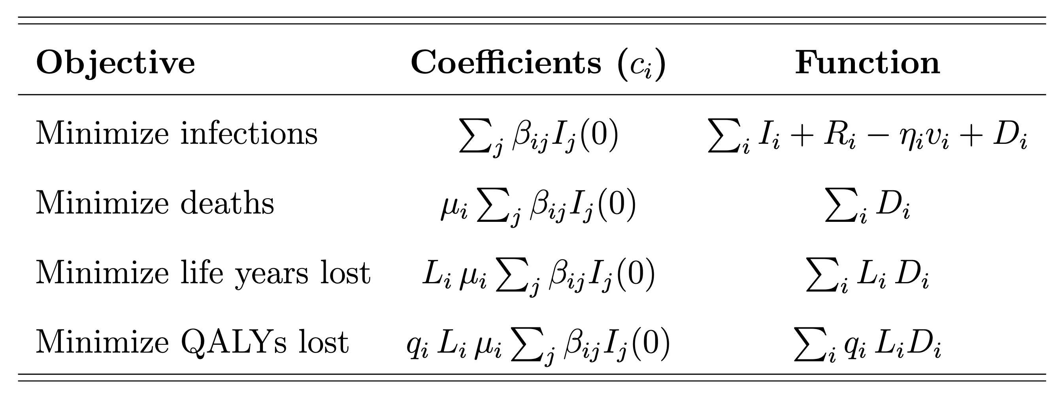



Approximated optimal solution
All-or-nothing allocation
    Optimal to vaccinate groups in decreasing order of the coefficients:
    Interpretable solution which requires minimal data
force of infection
$μ_{i}$: mortality rate
$L_{i}$: expected LYs lost
$q_{i}$: utility
Notes:
The priority order of this all-or-nothing allocation is given by the coefficients c_i of the objective function of the LP problem.
To minimize infections, it is optimal to prioritize groups with the highest initial force of infection. It makes sense to see the force of infection as we saw earlier that the force of infection is a good measure of the disease spread for each population group. (And is the leading term as we saw earlier??)
For deaths, the coefficient is the force of infection multiplied by the mortality rates mu_i. This term can be interpreted as the rate at which people die after being infected.
For life years and QALYs, the results follow directly from the objective of minimizing deaths. Because deaths are multiplied by L_i and q_i L_i in the objective functions, then so are the coefficients.
This solution is very interpretable and intuitive, we simply vaccinate groups in the priority order given by the coefficients c_i. The solution also requires minimal data and is easy to implement in practice. The only epidemic parameters these optimality conditions depend on are the force of infection, and the mortality rates in each population group.

Slide 17
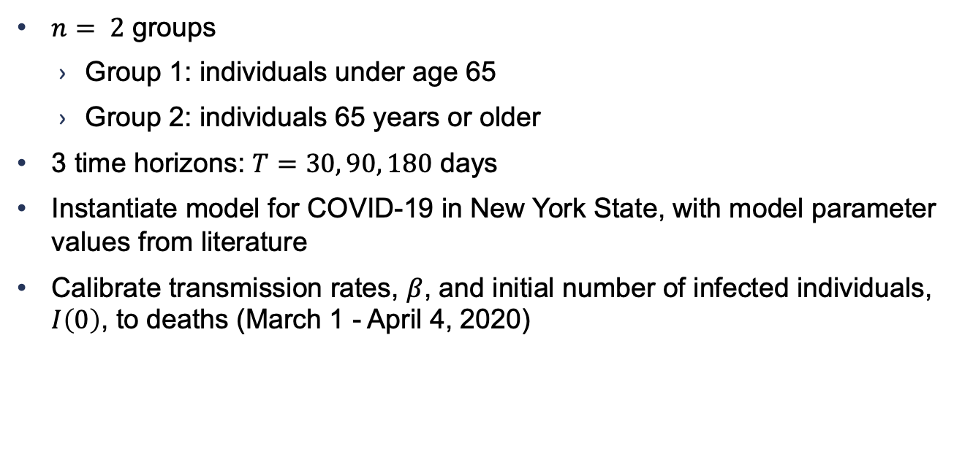
Example: COVID vaccination
  $n= 2$ groups
    Group 1: individuals under age 65
    Group 2: individuals 65 years or older
  3 time horizons: $T=30, 90, 180$ days
  Instantiate model for COVID-19 in New York State, with model parameter values from literature
  Calibrate transmission rates, $β$, and initial number of infected individuals, $I\left(0\right)$, to deaths (March 1 - April 4, 2020)
Notes:
I've presented an approximation of the disease dynamics that allowed us to gain insight into the optimal solution. Now the question is, are these approximations useful, can they inform good vaccine allocations.
In order to answer this, I illustrate the allocation method with the example of COVID-19 as a proof of concept. I divide the population into two age groups. I assume that group 1 consists of individuals under age 65 and group 2 consists of individuals 65 years or older.
I consider three different time horizons over which the objective functions are measured. They are of length 30, 90 and 180 days.
To instantiate the model, I use data for COVID-19 in New York State that includes daily confirmed cases and deaths. I also estimate values for model parameters from the literature.
Since several studies have shown that the total number of cases are underreported, I calibrate transmission rates and the initial number of infected individuals to a 7-day rolling average of reported deaths from March to April 2020. This time frame corresponds to the initial COVID outbreak in New York.

Slide 18
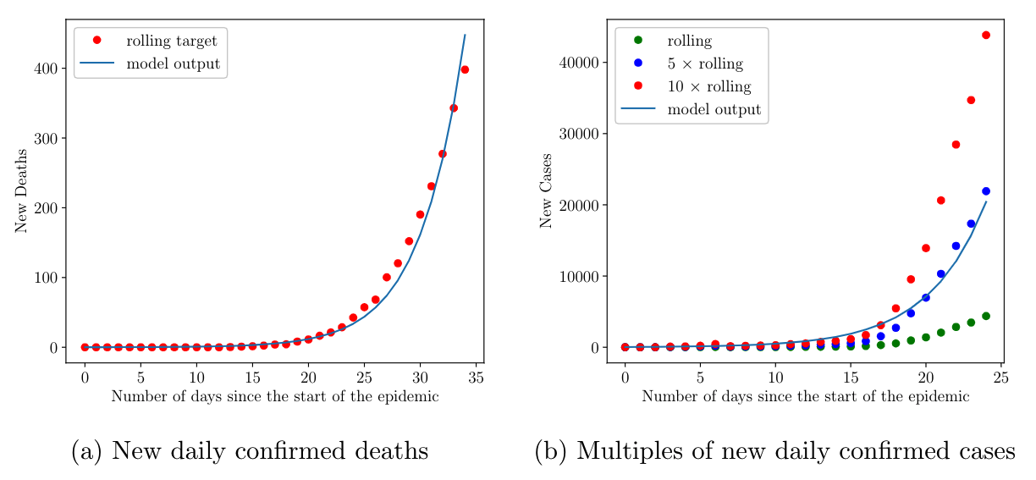
Calibration results
Notes:
The figure here shows the calibration results. I compare the models projected deaths (shown by the blue line) to reported deaths (shown by the red dots), and I find that the calibrated model’s output closely matches the reported deaths.
Even though I only calibrate to deaths, I still want to make sure that the model's projected cases reflect what is going on in the data. I compare the model’s projected cases to multiples of reported cases. I find that the model’s projections are 5 to 10 times higher than confirmed cases. This is consistent with other studies in the literature which suggest that the total number of infected people could be as high as 10 times the number of confirmed cases. This is due to a large population of asymptomatic or untested individuals.

Slide 19
Optimal vaccine allocation
Objective | Allocation
Minimize new infections | Group 1 (under 65)
Minimize deaths | Group 2 (65+)
Minimize life years lost | Group 2 (65+)
Minimize QALYs lost | Group 2 (65+)
Determine true optimal solution via exhaustive search using exact equations
Over a range of scenarios and number of available vaccines, approximate solution matches true optimal solution
Notes:
Using the calibrated parameters, I then determine the approximated optimal allocation for each objective. The allocations varied for the different objectives, but did not vary for the time horizon considered. To minimize infections, it is optimal to vaccinate younger individuals. That’s because individuals in the younger group have a higher transmission rates than individuals in the older group. However to minimize deaths, it is optimal to vaccinate older individuals. This is because their mortality rate is much higher. Similarly for life years and QALYs lost, it is better to vaccinate older individuals, as the gain in life years and QALYs for younger individuals is not enough to offset the higher mortality rate among older individuals. (Mortality in group 2 is 23 times higher than in group 1.)
These findings are consistent with CDC and other recommendations to prioritize older age groups for vaccination to minimize deaths.
I then evaluate the accuracy of the approximated optimal allocations with numerical simulations. I determine the optimal solution via exhaustive search using the exact equations of the SIR model.
I consider a wide range of scenarios, varying the length of the time horizon, transmission rates, the initial proportion of infected and recovered individuals, as well as the number of available vaccines. And I find that in all cases, the approximate solution matches the true optimal solution. The approximated solution performs very well.

Slide 20
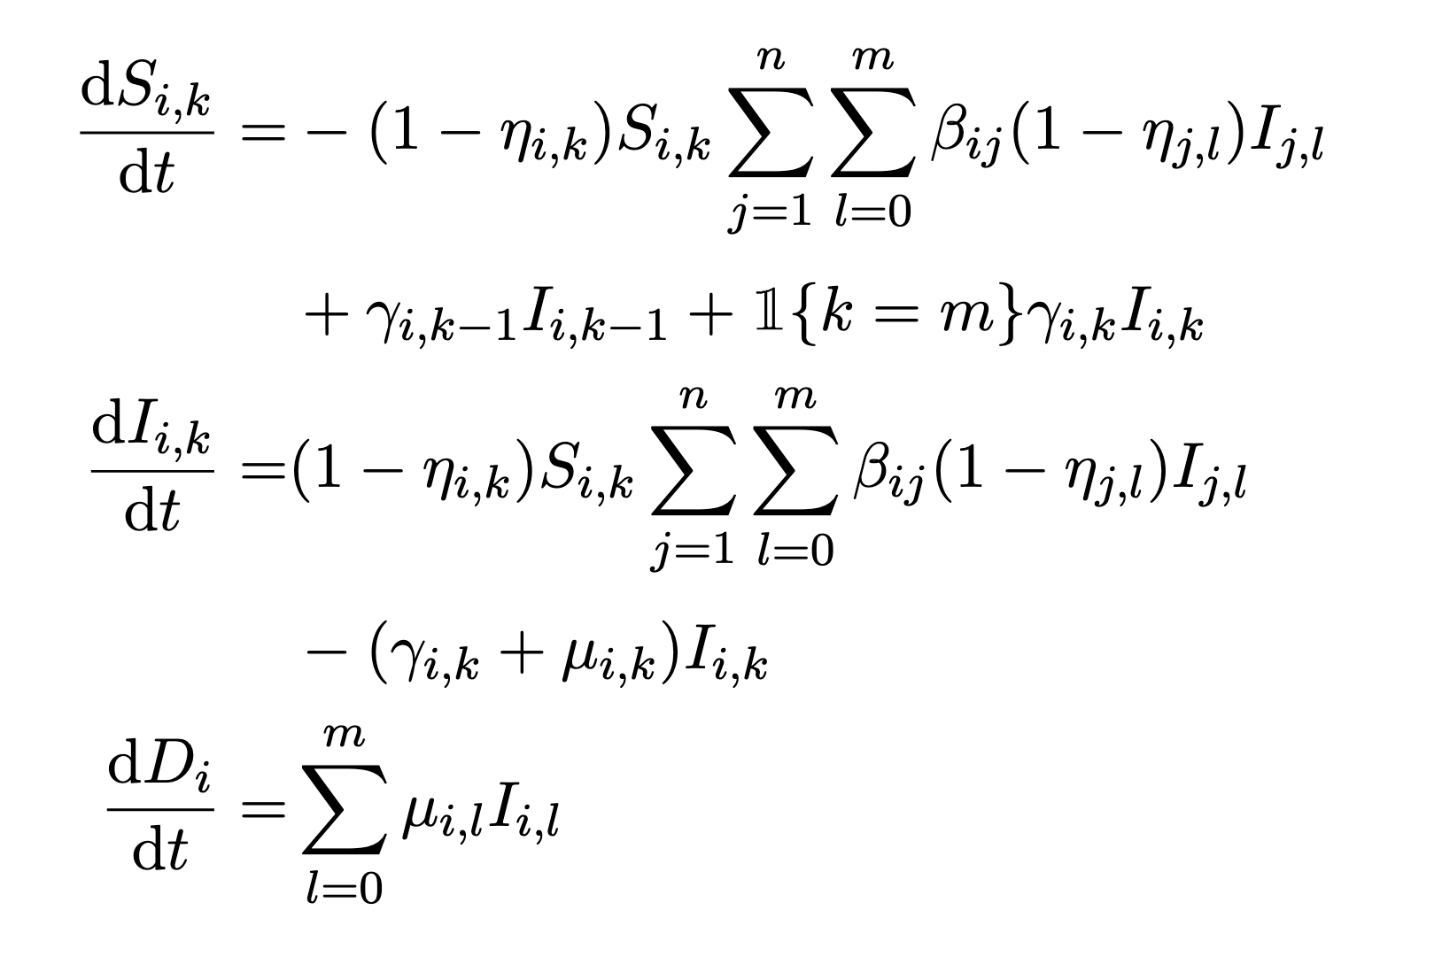



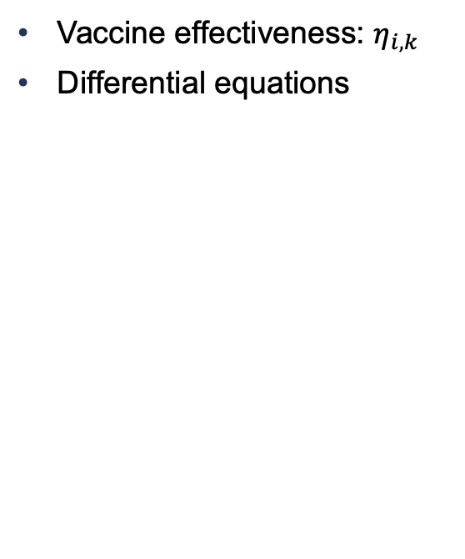













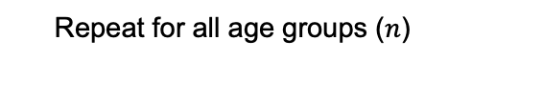



Endemic setting: initial vs. booster vaccine doses
Susceptible
$$β_{ii}$$
Infected
Dead
  Vaccine effectiveness: $η_{i,k}$
  Differential equations
$$S_{i,0}$$
$$I_{i,0}$$
$${(1−η_{i,1})β}_{ii}$$
$$μ_{i,0}$$
Force of
Infection: $λ_{i}$
$$γ_{i,0}$$
$$S_{i,1}$$
$$I_{i,1}$$
$$μ_{i,1}$$
$$D_{i}$$
$m$ doses
$$γ_{i,1}$$
. . . . . . .
$${(1−η_{i,m})β}_{ii}$$
$$μ_{i,m}$$
$$γ_{i,m−1}$$
$$S_{i,m}$$
$$I_{i,m}$$
$$γ_{i,m}$$
    Repeat for all age groups ($n$)
Notes:
The paper I just presented has several limitations. First, it considers a single allocation of vaccines. In reality, vaccination efforts extend over time. Second, the Taylor expansions I use provide reasonable approximations in the short term but might not be as accurate for longer time horizons. And finally, the work was published before it became clear that COVID will not be eradicated in the near future. To address these shortcomings, in this second paper, we extend the model to an endemic setting and consider booster doses to take into account waning immunity from vaccination. We also extend the framework to a dynamic setting, considering multiple time periods.
We augment the SIR model with new compartments to distinguish susceptible and infected individuals based on their immunity status. We assume that individuals can receive up to m vaccine doses. The figure shows the model for one population group, and the rows represent the different immunity levels.
The model now allows for reinfection: instead of having infected people move to the recovered group, they move to a higher immunity level.
[CLICK] We denote by $\eta_{i,k}$ the effectiveness of vaccine dose k for individuals in group $i$. And let $\beta_{ij}$ denote the transmission rate between susceptible individuals in population group $i$ and infected individuals in population group $j$. Vaccination dampens the transmission rates by a factor $(1-\eta_{i,k})$.
[CLICK] The model evolves over time according to this system of differential equations.
The force of infection here is the sum across all groups of the transmission rate multiplied by (1-eta_ik) and the infected compartment size.

Slide 21
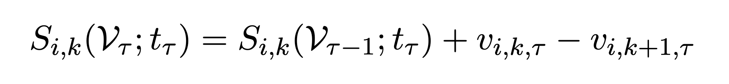









Multiple time periods setting
$$β_{ii}$$
  Allocation of vaccines over $T$ periods
  Vaccination at time period 𝜏:
  $${\left[V_{τ}\right]}_{i,k}=v_{i,k,τ}$$
Full set of vaccine allocation:
$$\text{𝒱} \text{=} \text{(}V_{1},…,V_{T})$$
Impact of vaccination:
$$S_{i,0}$$
$$I_{i,0}$$
$$μ_{i,0}$$
$$t$$
$${(1−η_{i,1})β}_{ii}$$
$$v_{i,1,τ}$$
$$t_{1}$$
$$t_{2}$$
$$t_{τ}$$
$$t_{T+1}$$
$$γ_{i,0}$$
$$S_{i,1}$$
$$I_{i,1}$$
$$μ_{i,1}$$
$$D_{i}$$
$$v_{i,2,τ}$$
$$γ_{i,1}$$
. . . . . . .
$${(1−η_{i,m})β}_{ii}$$
$$μ_{i,m}$$
$$γ_{i,m−1}$$
$$v_{i,m}$$
$$S_{i,m}$$
$$I_{i,m}$$
$$γ_{i,m}$$
Notes:
[CLICK] In this dynamic setting, we consider T discrete time periods.
Instead of a single allocation of vaccines, I assume that a limited number of vaccines are available to be distributed at the start of each time period.
[CLICK] Let me now introduce some notations. v_ik\tau is the proportion of individuals who receive dose k of the vaccine at the beginning of time period $\tau$ and belong to the age group i. V_tau is a matrix that captures the vaccine allocation at time period tau.
Capital V is the full set of vaccine allocation, and is our decision variable.
We assume that vaccination moves individuals to a higher level of immunity so vaccination and recovery from infection have the same effect in this model. Vaccination impacts the compartment sizes at the beginning of each time period in the following way: we add to the compartment S_ik individuals who are receiving dose k of the vaccine and remove individuals receiving their k+1 dose.

Slide 22
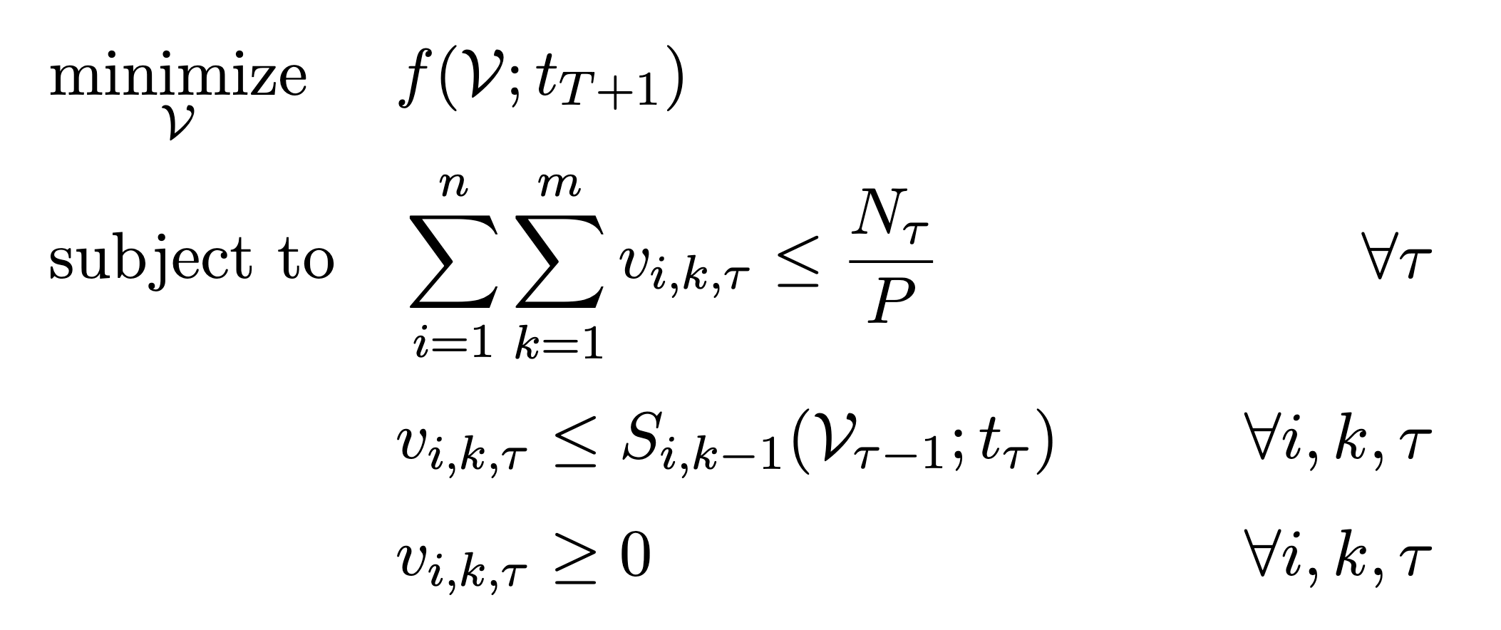
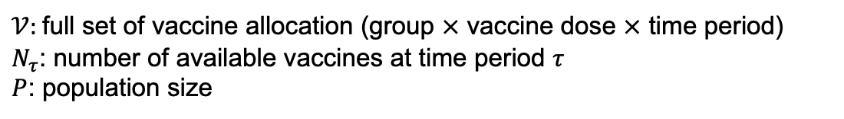
Optimization problem
$𝒱$: full set of vaccine allocation (group $×$ vaccine dose $×$ time period)
$N_{τ}$: number of available vaccines at time period $τ$
$P$: population size
Notes:
I formalize the optimal vaccine allocation problem considering multiple allocations.
I consider the same four objective functions, but the function f is a bit more complex here because it relies on the augmented SIR model that has new compartments to distinguish immunity levels.
I have similar constraints on vaccine allocation, but this time repeated for each time period.
What really changes is the decision space. We have two additional dimensions. Our decision variable, capital V captures the vaccine allocation for each group, vaccine dose and time period. Previously, we only chose a single allocation across groups, so the decision variable was an $n$-dimensional vector, whereas here we have a three dimensional array.
This is a much more complex problem because vaccination occurs over multiple time periods. In this dynamic setting, the epidemic evolves continuously, and at discrete time points, the trajectory is changed by vaccine allocation. And this vaccine allocation can have a nonlinear effect on epidemic evolution.

Slide 23
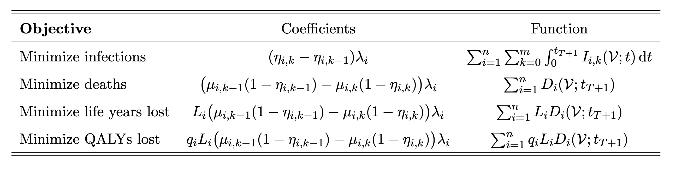



Sequential approach
For each time period, approximate disease dynamics using Taylor expansion for one time period
Extend approximation
    Remove constraint on vaccine supply:
  Piecewise linear problem with greedy solution
force of infection
$μ_{i}$: mortality rate
$L_{i}$: LYs lost
$q_{i}$: utility
Notes:
In order to derive interpretable conditions, I take a myopic approach: for each time period, I solve the previous optimization problem for a single time period.
I use Taylor expansions to approximate epidemic dynamics, but I extend the approximations to higher levels of vaccination. In the previous paper, I had to constrain the level of vaccination to be lower than the minimum of the alpha_is so that the approximations are realistic. Here, I am able to remove this constraint. With this relaxed assumption, the optimal vaccine allocation problem can no longer be reduced to a linear programming problem, but I show that the objective functions are piecewise linear with a greedy solution.
Similar to the previous paper, the greedy solution is an all or nothing allocation. We allocate vaccines in decreasing order of the coefficients summarized in this table.
[CLICK] To minimize infections, it is optimal to vaccinate group sin decreasing order of their initial force of infection multiplied by the incremental effectiveness of the vaccine dose.
[CLICK] For deaths, the coefficient is the force of infection multiplied by the mortality rates mu_i and the effectiveness of the vaccine dose.
[CLICK] For life years and QALYs, the coefficients are further multiplied by L_i and q_i L_i, as in the objective function.

Slide 24









Sequential approach
$$v_{0}$$
$$v_{1}$$
$$v_{τ}$$
$$v_{K}$$
$$t$$
$$0$$
$$t_{1}$$
$$t_{τ}$$
$$t_{K}$$
Update epidemic model
  Apply optimal allocation
  Simulate model numerically to determine the starting population at the next time period
  Repeat for each time period
  Heuristic approach to gain analytical insight
Notes:
To summarize the sequential approach: at time 0, I use the single-period optimality conditions to solve the problem for tau = 0. I then allocate the vaccines according to the optimal solution v_0. Given this vaccine allocation, the epidemic then evolves. Because the optimality conditions depend on the starting population at each time period, the model needs to be updated. We do so by simulating the model forward in time. I can then use the approximation to determine the optimal allocation at the next time period v1. I repeat this for each time period until I get the complete optimal vaccine allocation.
I take a myopic approach because if I were to use the Taylor series expansions directly in the original multi-period problem, I would get a non-convex problem with no analytical solution. I have instead chosen to use a heuristic approach that yields analytical insight.

Slide 25
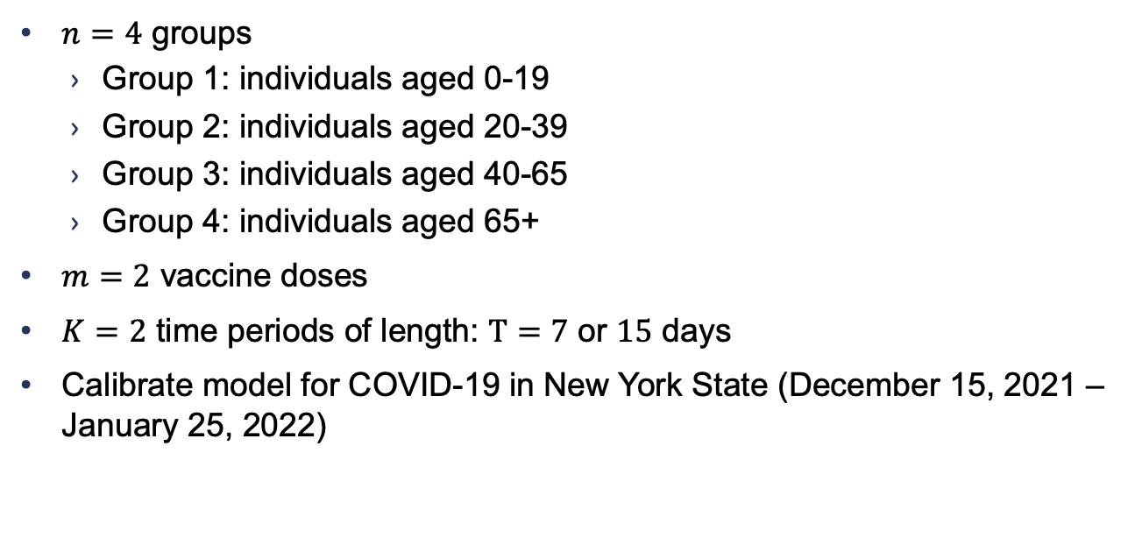
Example: COVID vaccination
  $n=4$ groups
    Group 1: individuals aged 0-19
    Group 2: individuals aged 20-39
    Group 3: individuals aged 40-65
    Group 4: individuals aged 65+
  $m=2$ vaccine doses
  $K=2$ time periods of length: $T=7$ or $15$ days
  Calibrate model for COVID-19 in New York State (December 15, 2021 – January 25, 2022)
Notes:
And I will now show with a numerical example calibrated to COVID-19 that this heuristic performs very well.
I divide the population into 4 age groups (individuals under age 20 (group 1), individuals aged 20-39 (group 2), individuals aged 40-65 (group 3), and individuals over age 65 (group 4))
[CLICK] I consider two vaccine doses (initial vaccine and booster shot), and two time periods with a length, of 7 and 15.
[CLICK] I calibrate the model using epidemic data for New York State from December 2021 to January 2022. This time frame corresponds to the omicron wave.

Slide 26
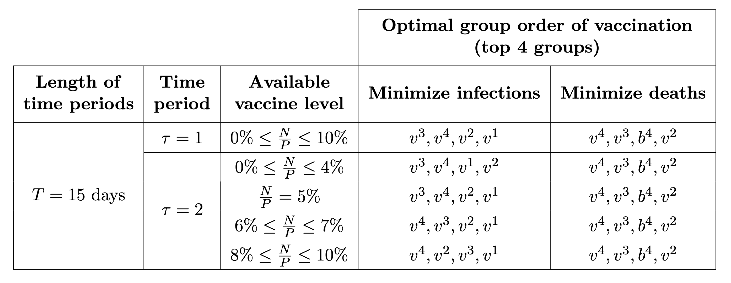
Results
  Group 1: individuals aged 0-19
  Group 2: individuals aged 20-39
  Group 3: individuals aged 40-65
  Group 4: individuals aged 65+
Approximated solution is near optimal: true numerical and approximated solution differ by < 1%
Notes:
Using the calibrated parameters, I then determine the approximated optimal allocation for each objective. In the interest of time, I will only present results for the objective of minimizing infections and deaths for a time period length of 15 days, but the intuition holds for the other scenarios.
This table shows the optimal group order of vaccination for the top 4 groups. Vi means vaccination group i, bi means boosting group i.
To minimize infections, it is optimal to prioritize initial vaccines over booster doses because the incremental effectiveness of boosters is lower than the effectiveness of initial vaccines.
However to minimize deaths, it is optimal to vaccinate older age groups, then provide boosters to individuals $\geq$65 years old.

Slide 27
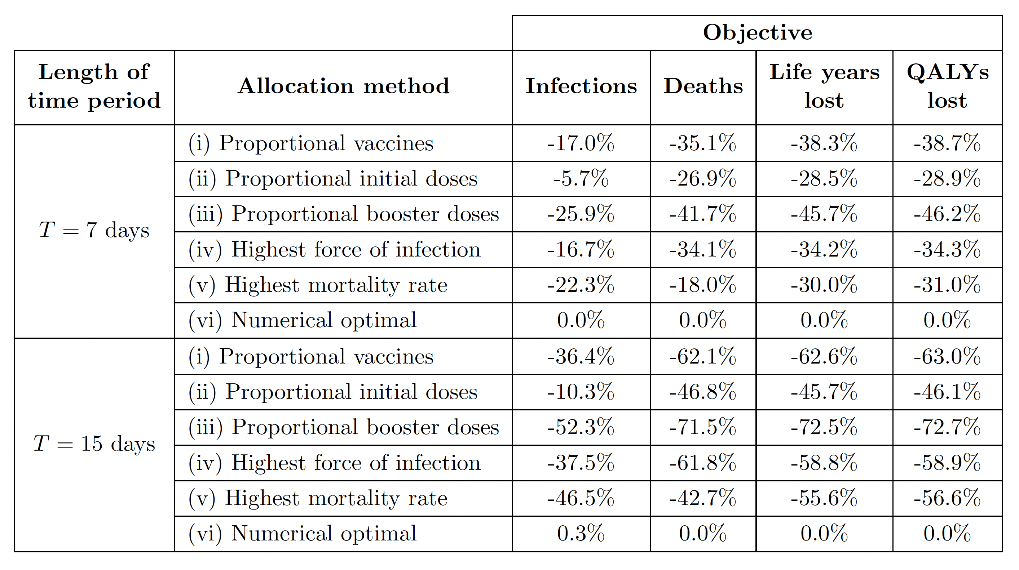
Benefits of our vaccination rules
Outcomes with approximated optimal solution are significantly better than with simple allocation methods
Notes:
Finally, we compare the approximated optimal allocation to commonly used heuristic policies (first five lines). Using simulation, we evaluate reductions in infections, deaths, life years lost, and QALYs lost when 10% of the population is vaccinated. The table shows that the approximated allocation substantially outperforms simple allocation rules, reducing 70% of deaths compared to allocating booster doses proportionally.

Slide 28
Conclusions
Quality-adjusted life years (QALYs) are typically used in health economics, but the appropriate objective depends on the decision environment
Addresses gaps in current approaches
Previous models | My model
Black box models | Interpretable, actionable, and accurate solution
Solves specific instance | General theoretical framework
Careful calibration of epidemic parameters | Minimal data
Notes:
A few thoughts to conclude. QALYs are generally used in health economics to measure health outcomes. However, the appropriate objective for vaccine allocation depends on the decision environment.
The model I developed addresses gaps in current approaches. Most studies on vaccine allocation rely on black box models. My model, on the other hand, provides interpretable, actionable and accurate insights into resource allocation problems. Interpretability is especially important in public health as policy makers are expected to be accountable for their decisions.
Additionally, most models in the literature only solve a specific instance of the problem and require careful calibration of epidemic parameters. Whereas the general theoretical framework that I developed requires minimal data and can be adapted to other public health challenges for epidemic control beyond COVID-19.

Slide 29

Thank you!
Develop analytical models to inform complex decisions in public health
Interpretable models for vaccine allocation
    Objective depends on decision environment
    Piecewise linear problem with interpretable all-or-nothing optimal allocation
    Near-optimal solution
    General theoretical framework
isabelle.rao@utoronto.ca | isabellerao.com

Slide 30
Appendix

Slide 31
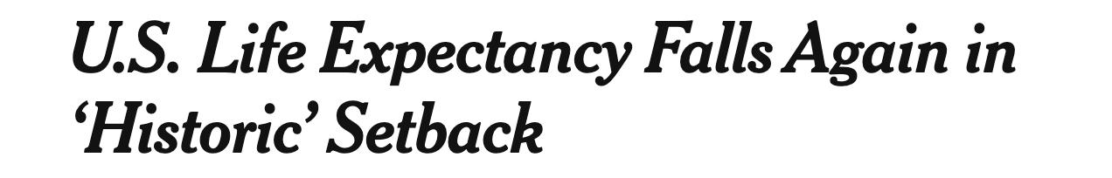
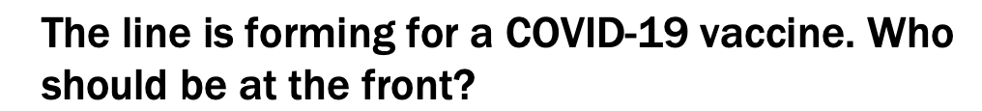

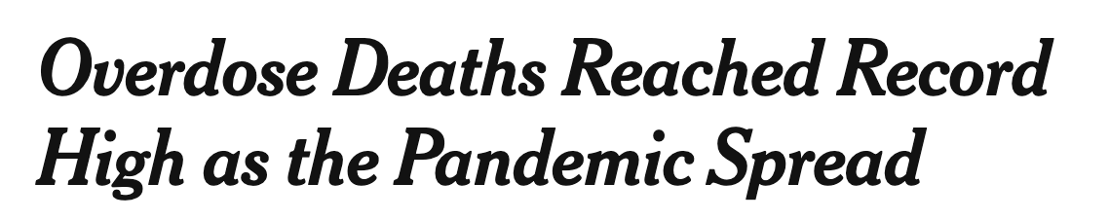
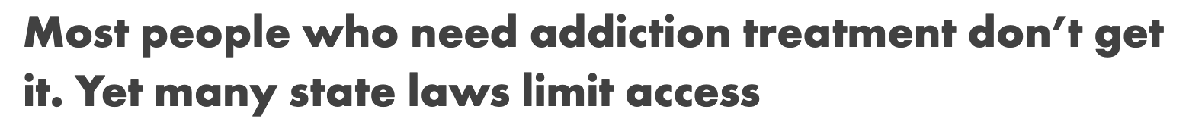
My research
Notes:
I want to start by providing some motivation for my research. Over the past few years, through public health crisis such as COVID-19 and opioid use disorder, it has become clear that we are unprepared for epidemics. Part of the trouble is that we don’t know how to respond to epidemics as emphasized by these headlines.
Add sources and dates

Slide 32
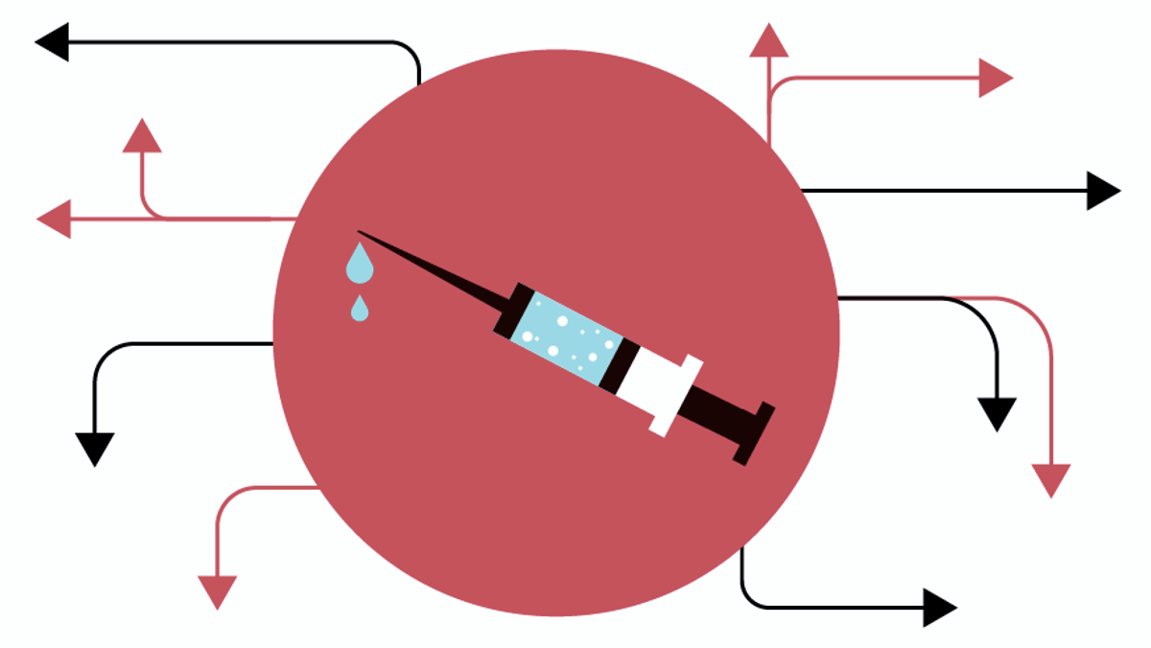
Complexities of vaccine allocation problem
Epidemics are dynamic
Epidemics are stochastic
Epidemics grow nonlinearly
Limited vaccine supply
Vaccination not instantaneous
Limited vaccine demand
Notes:
The optimal vaccine allocation problem is very challenging for a number of reasons. First of all, modeling epidemics is complex because they are dynamic, stochastic and grow nonlinearly.
Additionally, looking at the vaccine side of the problem, the vaccine supply is limited, vaccination of susceptible individuals is not instantaneous, as it takes time for individuals to start building immunity to the disease. And finally, not only is vaccine supply limited, but vaccine demand might also be limited as some individuals may hesitate to get vaccinated. In the US at the height of the pandemic I think, only 70% of the population have at least one dose of a vaccine against COVID-19.

Slide 33















Extensions to the model
Birth and natural deaths:
Equity constraints:
Vaccine hesitancy:
Exposed compartment (SEIS):
$$β$$
$$R$$
$$γ$$
$$S$$
$$I$$
$$μ$$
$$D$$
$$β$$
$$R$$
$$S$$
$$E$$
$$I$$
$$γ$$
$$μ$$
$$D$$
Notes:
For simplicity, we assumed no entry into or exit from the population. When these transitions are included in the model, they appear as constant terms in the resulting Taylor series approximations, and so the optimization results are unchanged.
We can also extend our work to include fairness considerations. For example, this equity constraint can be added to the optimization problem, where mi,k is the minimum level of vaccination in the susceptible compartment Si,k
We could also add this constraint to reflect vaccine hesitancy or lack of vaccine access among certain population groups. The level of vaccination v_ik could be constrained to be lower than ϕi,k Si,k(0), where ϕi,k is the vaccine acceptance rate in group i for vaccine dose k.
We can augment the SIS model with an additional exposed compartment for individuals who are infected but not yet infectious. Susceptible individuals who become infected move to the exposed compartment E. Exposed individuals then become infectious and move to compartment I. We use second-order Taylor expansions for the objective of minimizing cumulative infections, and third-order Taylor expansions for the objectives of minimizing deaths, life years lost, and QALYs lost due to death.

Slide 34
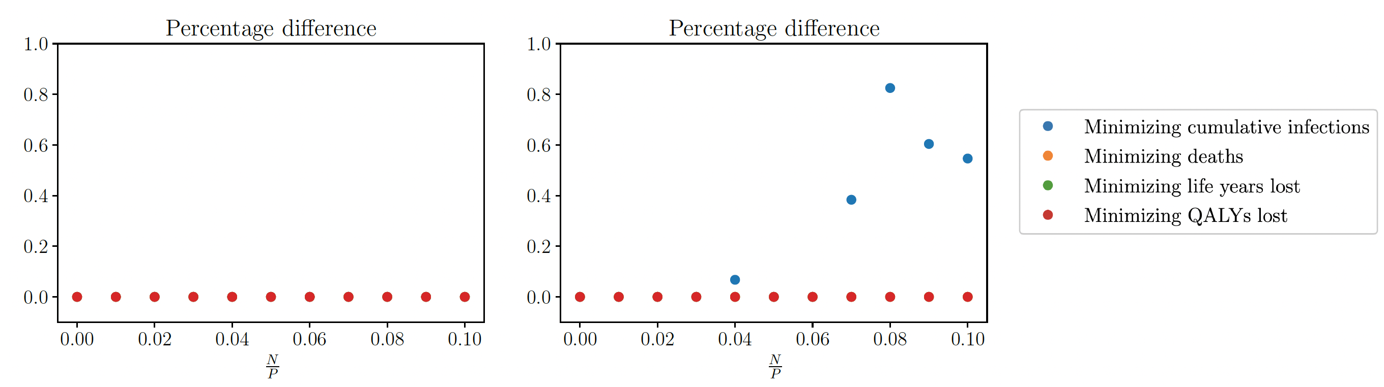



Quality of decisions
  Determine true optimal solution via exhaustive search
  Approximated solution is near optimal: true numerical and approximated solution differ by < 1%
Difference (%) between the objective function at the numerical and approximated optimal solution
$T =15$days
$$τ=1$$
$$τ=2$$
Notes:
I then evaluate the accuracy of the approximated solution with numerical simulations. I determine the optimal solution via exhaustive search using the exact equations of the SIR model. I find that the approximated solution is near optimal. It differs from the numerical solution by at most 1%.
In the interest of time, I only present results for a time horizon of 15 days. Results qualitatively hold across all time horizons. This figure here shows the percentage difference between the value of the objective function at the numerical and approximated optimal solution for all three time periods. For the objectives of minimizing deaths, life years lost, and QALYs lost, the approximated optimal solution matches the numerical optimal solution in all cases (for any level of vaccination and time period).
[CLICK] For the objective of minimizing new infections, the approximated and numerical solutions differ slightly in the third time period for N/P > 4%.
The reason they differ is because the numerical solution will sometimes do partial allocation, whereas the approximation doesn't capture diminishing returns and is an all or nothing allocation.
Reason differ is because numerical optimal at certain point will divide, whereas approximated is all or nothing. Won’t capture diminishing returns.

Slide 35

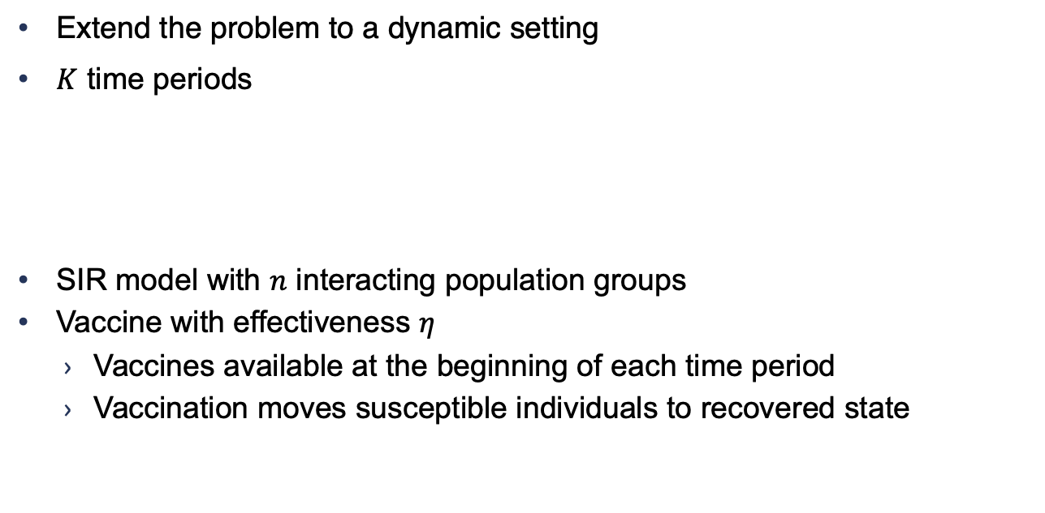





Multiple time periods setting
  Extend the problem to a dynamic setting
  $K$ time periods
  SIR model with $n$ interacting population groups
  Vaccine with effectiveness $η$
    Vaccines available at the beginning of each time period
    Vaccination moves susceptible individuals to recovered state
$$t$$
$$0$$
$$t_{1}$$
$$t_{2}$$
$$t_{τ}$$
$$t_{K}$$
Notes:
The paper I just presented considers a single allocation of vaccines. In reality, vaccination efforts extend over time. Additionally, the Taylor expansions I use provide reasonable approximations in the short term but might not be as accurate for longer time horizons. To address these shortcomings/limitations, In this second paper, I extend the framework to a dynamic setting, considering multiple time periods.
I consider K discrete time periods. I index the time periods by \tau, and denote by t_\tau the beginning of time period \tau.
I consider the same SIR model with n interacting population groups, and assume that a preventive vaccine with effectiveness eta is available. Instead of a single allocation of vaccines, I assume that a limited number of vaccines are available to be distributed at the start of each time period.
The allocation of vaccines moves susceptible individuals to the recovered health state as before.

Slide 36
Taylor expansions
$$β$$
$$R$$
$$γ$$
$$S$$
$$I$$
$$D$$
  Deaths
    SIR:
    Approximation:
    Additional constraint:
$$μ$$
Notes:
For deaths, the problem is similar so I will describe it briefly. With the SIR model, the rate of change of D is proportional to the infected compartment size, which is always positive, so D is always increasing.
But with the approximation, the rate of change could be negative since the approximation I tilde could be negative. So I need to add the same constraint as previously so that the approximation of deaths is always increasing, which makes sense because deaths is a trapping state in my model.

Slide 37
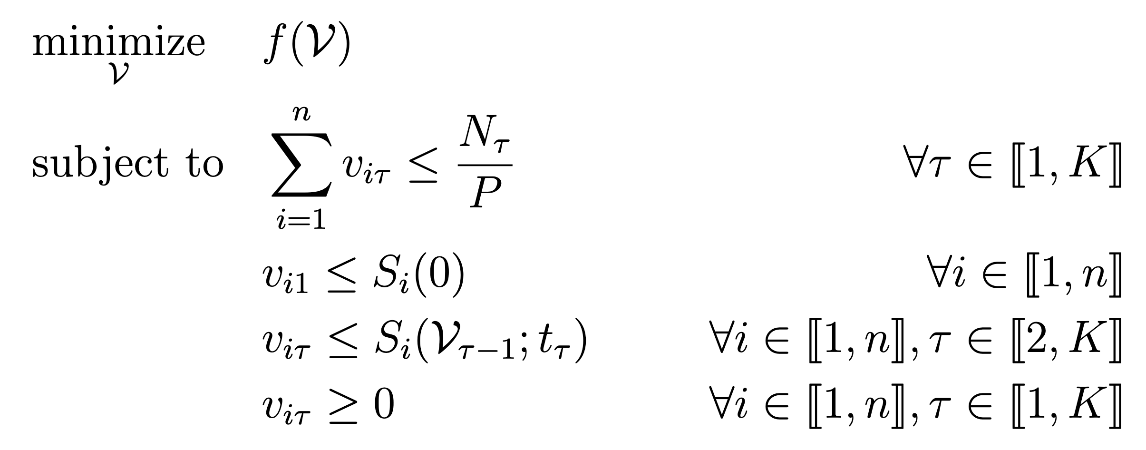
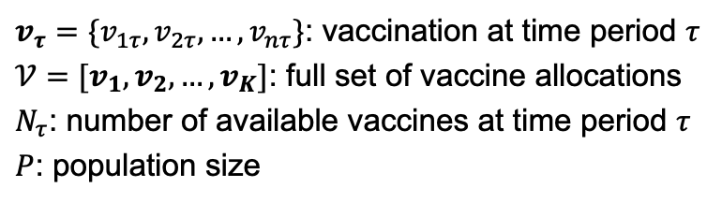
Optimization problem
$v_{τ}=\{v_{1τ},v_{2τ},…,v_{nτ}\}$: vaccination at time period $τ$
$𝒱=[v_{1},v_{2}, …,v_{K}]$: full set of vaccine allocations
$N_{τ}$: number of available vaccines at time period $τ$
$P$: population size
nonlinear impact on epidemic evolution
Notes:
I formalize the optimal vaccine allocation problem considering multiple allocations.
I consider the same four objective functions, and I have similar constraints on vaccine allocation, but this time repeated for each time period. The most important difference here is that we have an additional time component to the problem. We are minimizing over the full set of vaccine allocation, denoted by capital V. V is the vaccine allocation for each group and at each time period. V here is an n by K matrix, whereas previously we were minimizing over an n dimensional vector. This is much more complex because vaccination occurs over multiple time periods. In this dynamic setting, the epidemic evolves continuously, and at discrete time points, the trajectory is changed by vaccine allocation. And this vaccine allocation can have a nonlinear effect on epidemic evolution.

Slide 38
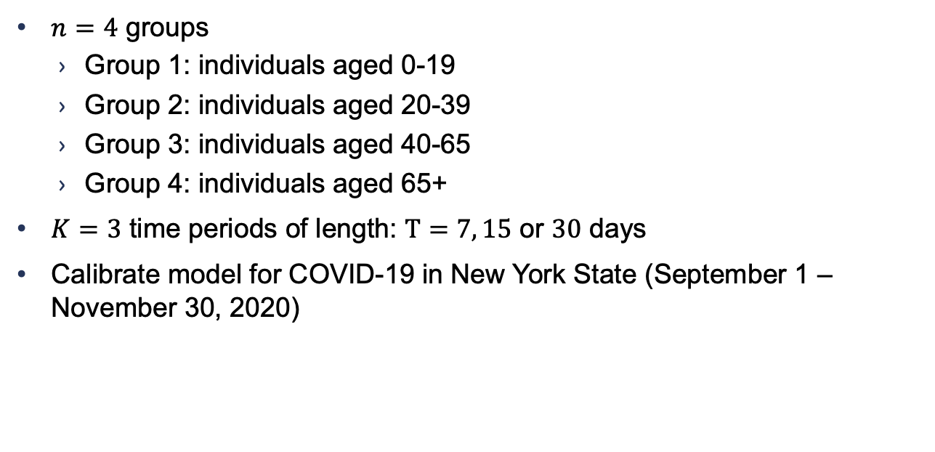
Example: COVID vaccination
  $n=4$ groups
    Group 1: individuals aged 0-19
    Group 2: individuals aged 20-39
    Group 3: individuals aged 40-65
    Group 4: individuals aged 65+
  $K=3$ time periods of length: $T=7, 15$ or $30$ days
  Calibrate model for COVID-19 in New York State (September 1 – November 30, 2020)
Notes:
And I will now show with a numerical example calibrated to COVID-19 that this heuristic performs very well.
I divide the population into 4 age groups (individuals under age 20 (group 1), individuals aged 20-39 (group 2), individuals aged 40-65 (group 3), and individuals over age 65 (group 4))
I consider three time periods with a shorter length, of 7, 15, and 30 days.
I calibrate the model using epidemic data for New York State from September to November 2020. This time frame corresponds to the second COVID wave, and it was the latest available data when the paper was published.

Slide 39
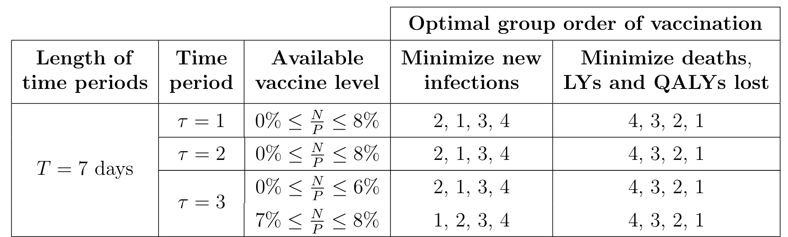
Results
  Group 1: individuals aged 0-19
  Group 2: individuals aged 20-39
  Group 3: individuals aged 40-65
  Group 4: individuals aged 65+
Minimize new infections: vaccinate people who are spreading the disease
Minimize deaths: consistent
with CDC recommendations
Notes:
Now that I've calibrated the model, I can determine the optimal vaccine allocation for each time period. The results hold across all time period lengths, so I will only present results for a time period length of 7 days. For the objective of minimizing infections, in the first and second time periods, group 2 (which consists of individuals aged 20-39) is vaccinated first for all vaccination levels. In the third time period, the allocation prioritizes group 1 over group 2 for higher levels of vaccination. The takeaway here is that to minimize infections, it is optimal to vaccinate groups that spread the infection the most.
To minimize deaths, life years lost, and QALYs lost, older age groups are prioritized. This is intuitive because mortality increases significantly with age.
These findings are consistent with CDC and other recommendations to prioritize older age groups for vaccination to minimize deaths.

Slide 40




Quality of decisions
  Approximated solution is near optimal: true numerical and approximated solution differ by at most 0.018%
$T = 7$days
Difference (%) between the objective function at the numerical and approximated optimal solution
$$τ=1$$
$$τ=2$$
$$τ=3$$
Notes:
I then evaluate the accuracy of the approximated solution by comparing it to the true numerical solution found using exhaustive search. I find that the approximated solution is near optimal. It differs from the numerical solution by at most 0.02%.
In the interest of time, I only present results for a time horizon of 7 days. Results qualitatively hold across all time horizons. This figure here shows the percentage difference between the value of the objective function at the numerical and approximated optimal solution for all three time periods. For the objectives of minimizing deaths, life years lost, and QALYs lost, the approximated optimal solution matches the numerical optimal solution in all cases (for any level of vaccination and time period). For the objective of minimizing new infections, the approximated and numerical solutions differ slightly in the third time period for 6% ≤ N/P ≤ 7%.

Slide 41


Quality of decisions
$T=7$ days
$$τ=3$$
Approximated and numerical optimal
allocation to minimize infections
Approximated solution
Numerical solution
Run time: < 1 second
$≈$ 2 hours
2,1,3,4
1,2,3,4
Notes:
Let’s take a closer look at why the two solutions differ. The figure shows the approximated and numerical optimal allocation. And here I have written the priority order given by the approximated solution. We see that the discrepancy in allocations occurs close to the switching point: the approximated solution allocates all vaccines to group 2 when N/P= 6%, and to group 1 when N/P= 7%. In contrast, the numerical optimal solution allocates vaccines to both groups 1 and 2 when 6%≤N/P≤7%. The switch occurs more gradually in the numerical solution whereas the approximated solution is an all-or-nothing allocation, which is not always optimal. But the numerical solution nevertheless follows the priority order given by the approximated solution, prioritizing group 2 here and group 1 here.
One other thing I want to mention here, is that in addition to being interpretable, the approximated solution is also computationally much more efficient than the numerical solution. For example, the approximated solution takes less than a second to run, whereas the numerical solution takes around 2 hours to run. You could think that two hours is not so long, it's still feasible, but you could imagine problems that are more complex, with more population groups or a smaller grid size, where exhaustive search would become intractable, whereas my approximation would still run in a reasonable time.

